Slide 1


Affective Neuroscience | Fall 2020
Lecture 05 | 110620
Lecture 05
Touch and Nociception
CHOONG-WAN WOO | COCOAN lab | http://cocoanlab.github.io
Many slides are modified from Tor D. Wager’s slides

Slide 2
Lecture 05 | 110620
Learning goals
Learn about the different pathways that carry touch and pain-related (nociceptive) information to the brain
Somatosensory system’s three major functions
Exteroceptive
Interoceptive
Proprioceptive
CHOONG-WAN WOO | COCOAN lab | http://cocoanlab.github.io

Slide 3
Lecture 05 | 110620
Touch and nociception in the skin
Touch: “our tactile world is rich, if not infinite” (Abraira & Ginty 2013)
Nociception is the process by which potentially damaging thermal, mechanical, or chemical stimuli are detected by a subpopulation of peripheral nerve fibers, called nociceptors.
Nociception is the sensory transmission most closely related to pain.
Specialization of receptors in skin and other organs for specific types of touch
Labeled lines: Separate pathways conveying different types of information
Pain and touch are intricately related
CHOONG-WAN WOO | COCOAN lab | http://cocoanlab.github.io

Slide 4
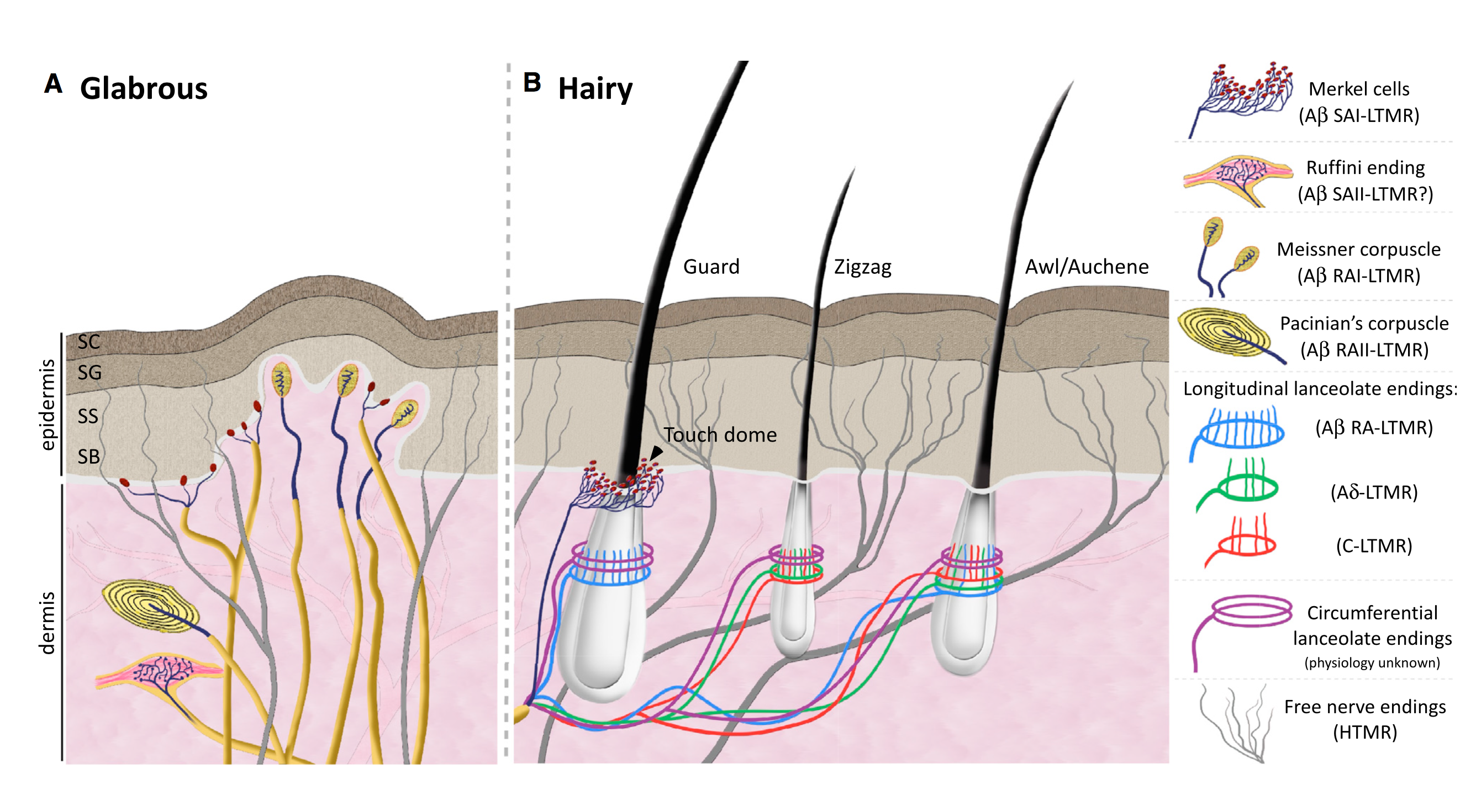
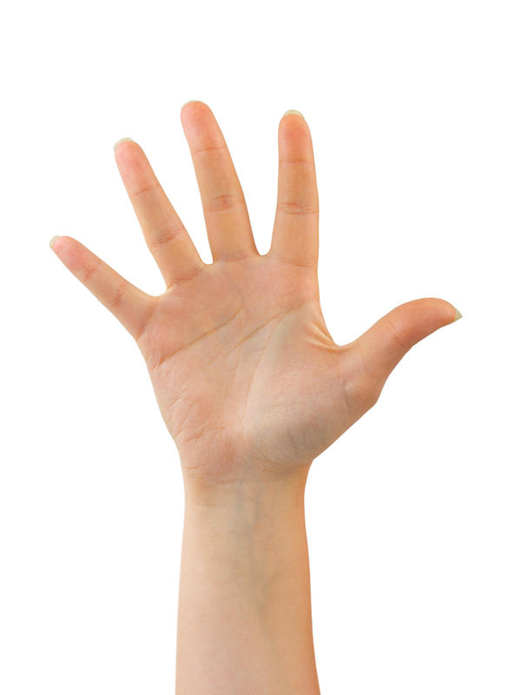
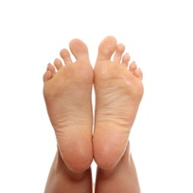
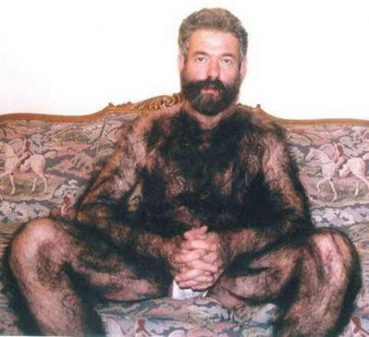
Lecture 05 | 110620
Mammalian skin is
glabrous
hairy
or
skin identation, skin vibration, skin stretching
Specialized for nociception (pain-related): Free nerve endings, C and A-delta fibers
CHOONG-WAN WOO | COCOAN lab | http://cocoanlab.github.io
Abraira & Ginty (2013)

Slide 5
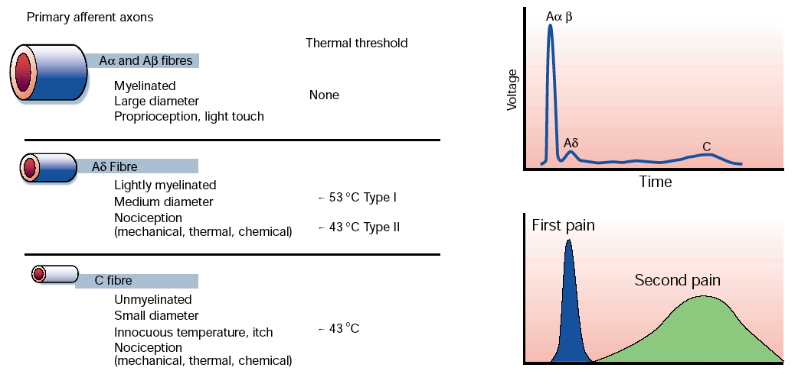
Lecture 05 | 110620
Three fiber groups
Fastest
16 - 100 m/s (30 – 230 mph)
Glutamate
Slower
5 - 30 m/s (10 – 70 mph)
Pricking pain
Glutamate
0.5 - 2 m/s (1 – 5 mph)
Dull, burning pain
Emotional touch
Less localized
Glutamate
Peptides
(Sub. P)
CHOONG-WAN WOO | COCOAN lab | http://cocoanlab.github.io
Julius & Basbaum, Nature, 2001

Slide 6
Lecture 05 | 110620
First pain vs. second pain
Fastest
16 - 100 m/s (30 – 230 mph)
Glutamate
Slower
5 - 30 m/s (10 – 70 mph)
Pricking pain
Glutamate
0.5 - 2 m/s (1 – 5 mph)
Dull, burning pain
Emotional touch
Less localized
Glutamate
Peptides
(Sub. P)
CHOONG-WAN WOO | COCOAN lab | http://cocoanlab.github.io
Julius & Basbaum, Nature, 2001

Slide 7
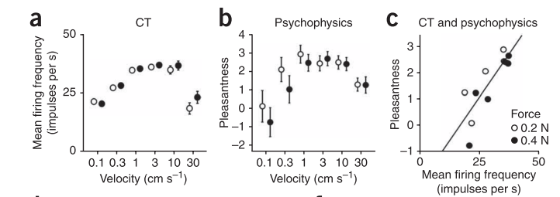
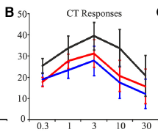
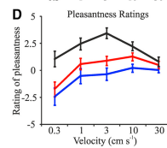
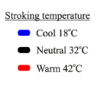
Lecture 05 | 110620
C tactile (CT) afferents
Respond best to pleasant stroking in hairy skin
Respond best to pleasant stroking at skin temperature
CHOONG-WAN WOO | COCOAN lab | http://cocoanlab.github.io
Löken et al, Nat Neurosci, 2009; Ackerley et al, JN, 2014

Slide 8
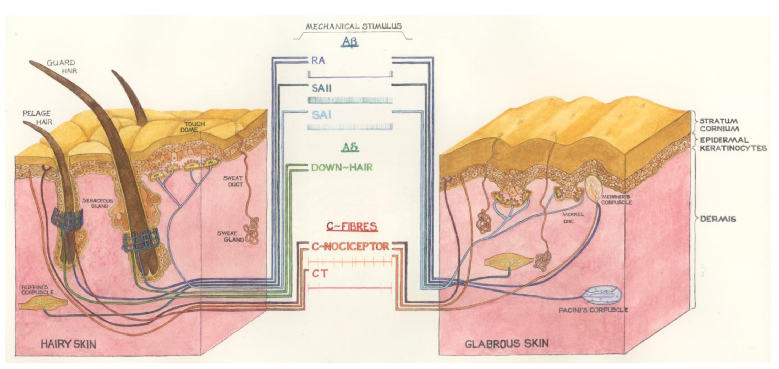
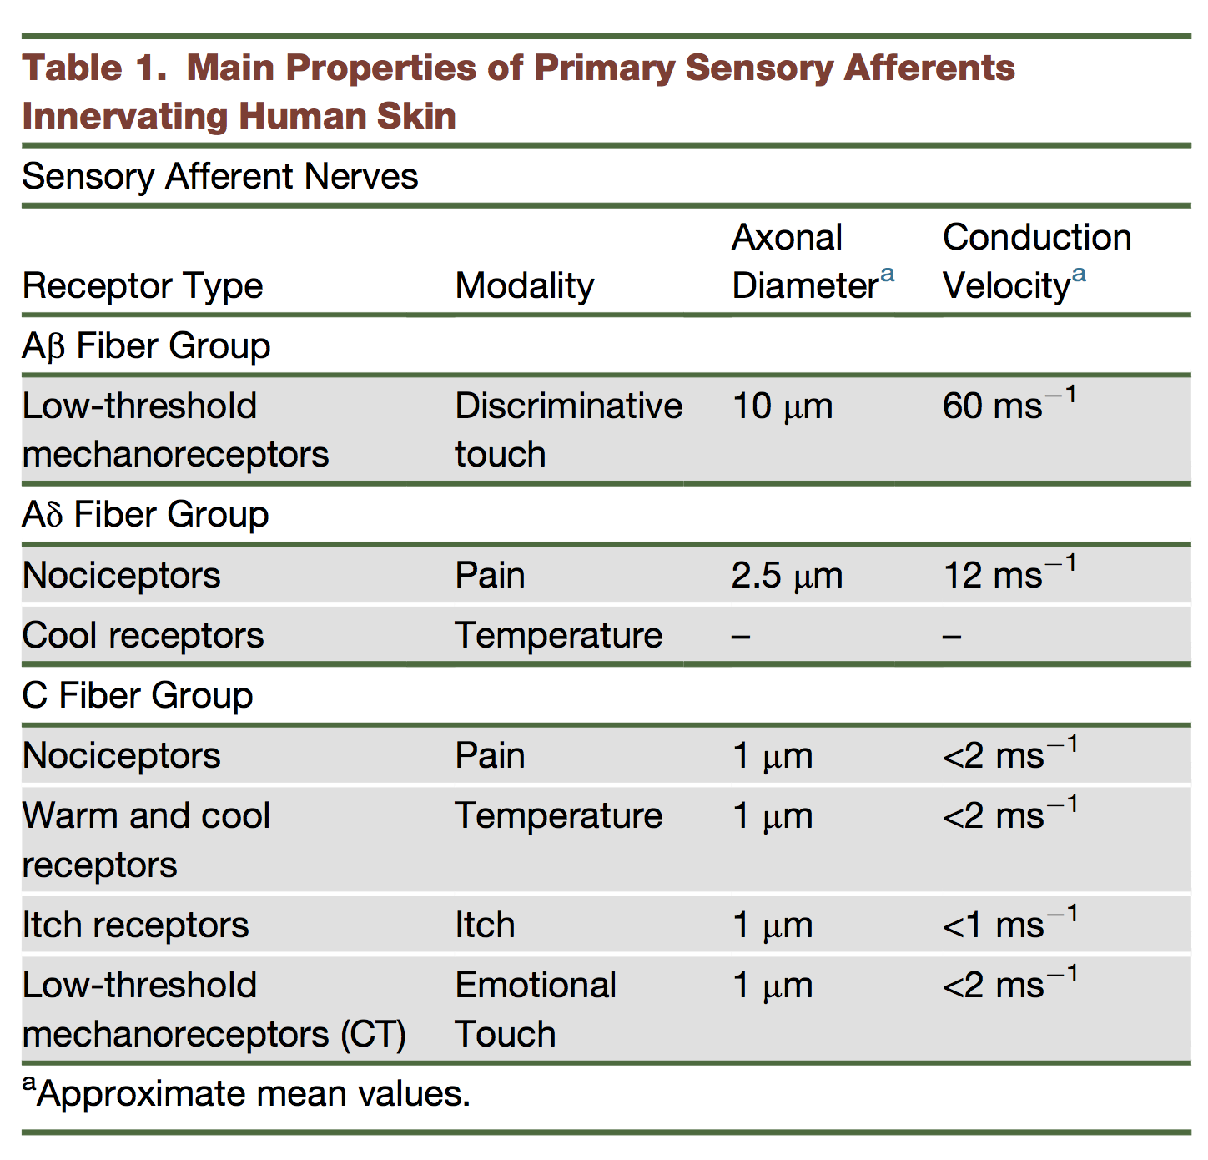
Lecture 05 | 110620
Fiber types: summary
CHOONG-WAN WOO | COCOAN lab | http://cocoanlab.github.io
McGlone et al., 2014

Slide 9
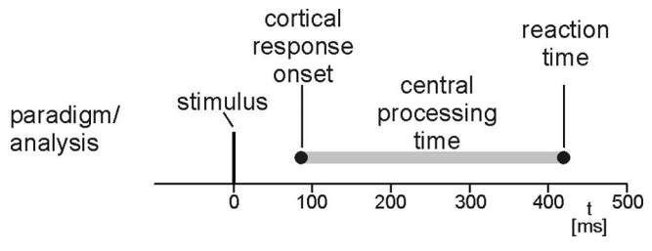
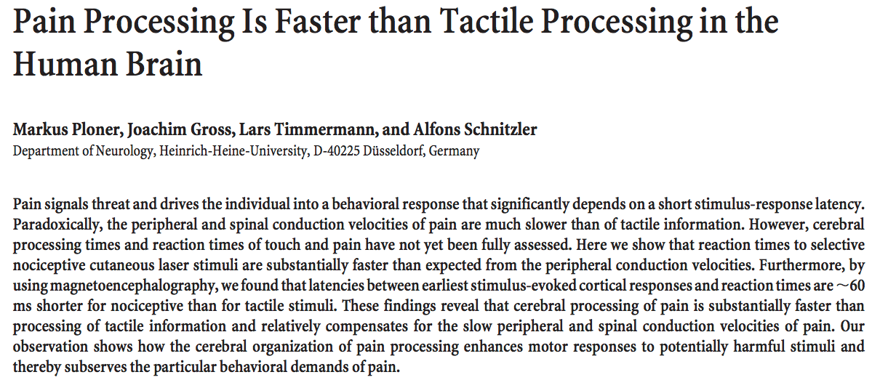
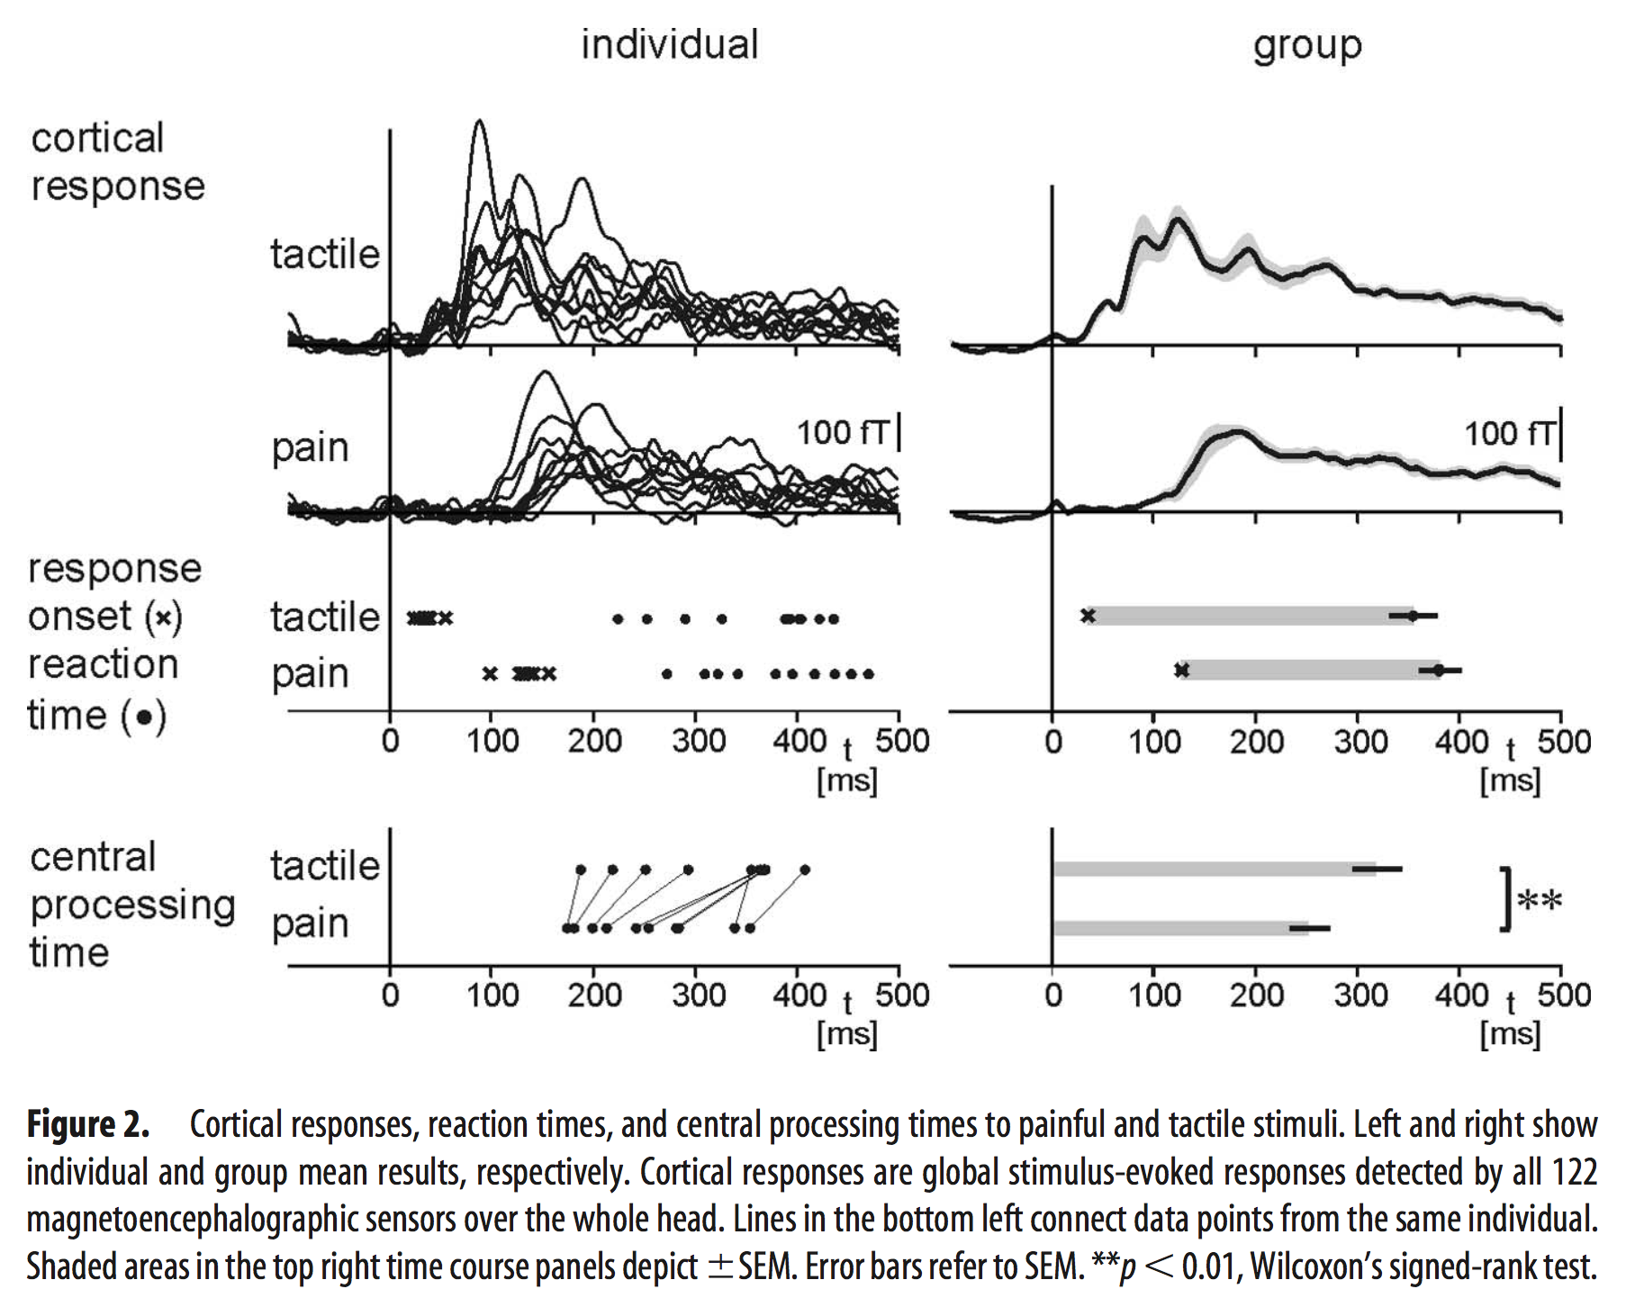
Lecture 05 | 110620
Why pain slower than touch?
CHOONG-WAN WOO | COCOAN lab | http://cocoanlab.github.io
Ploner et al., 2006

Slide 10
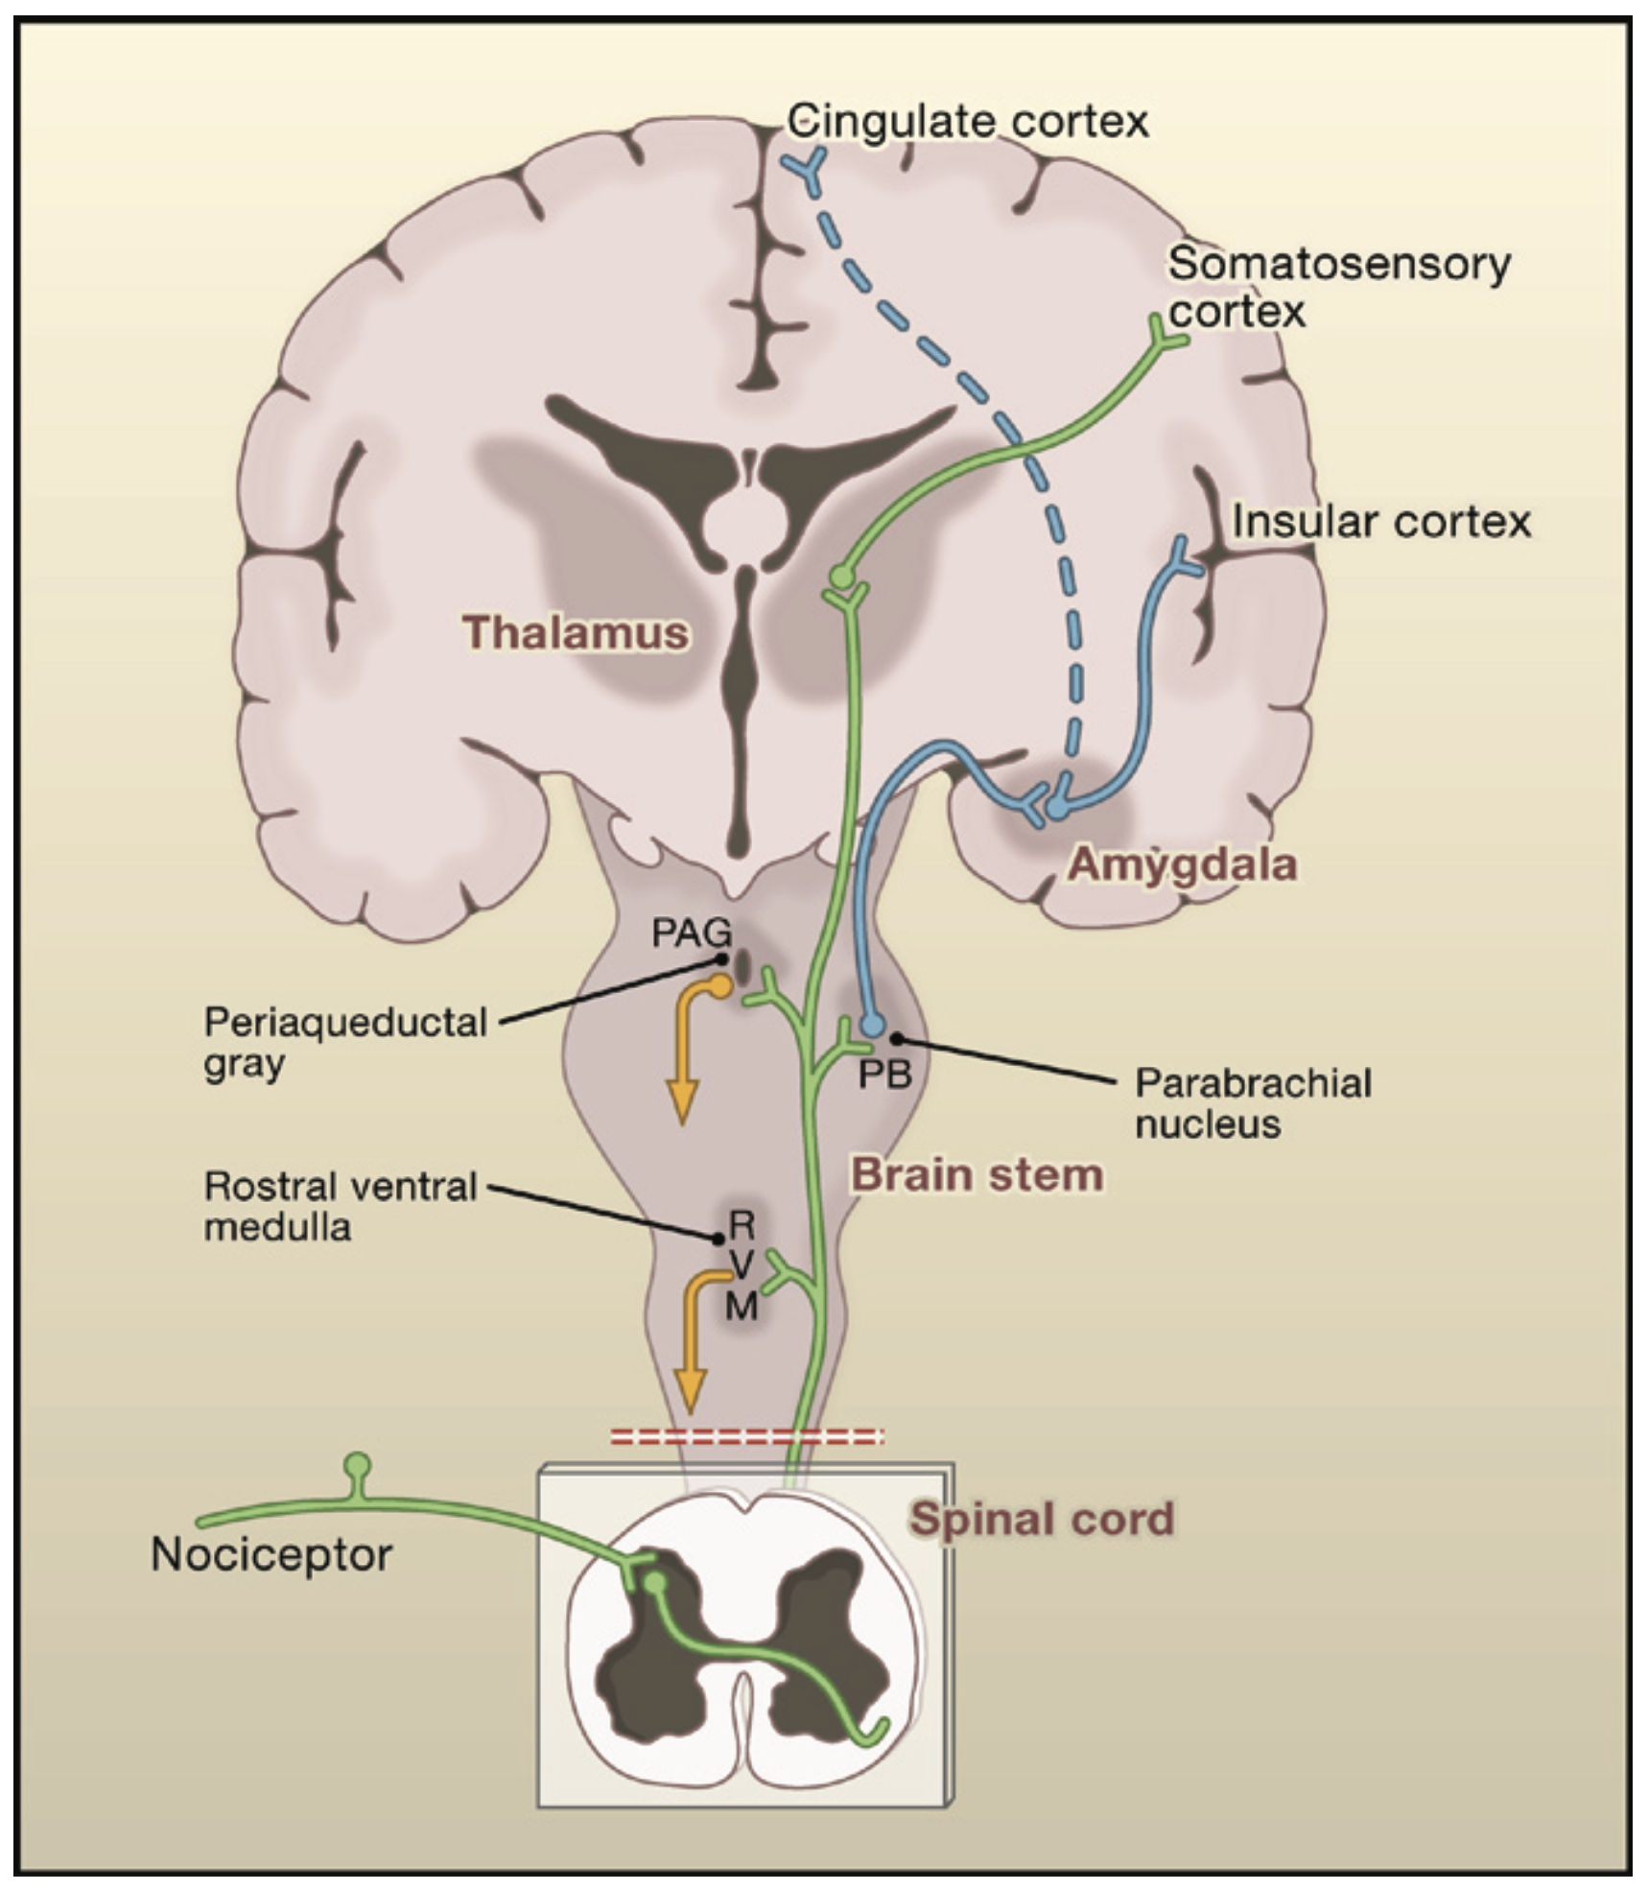
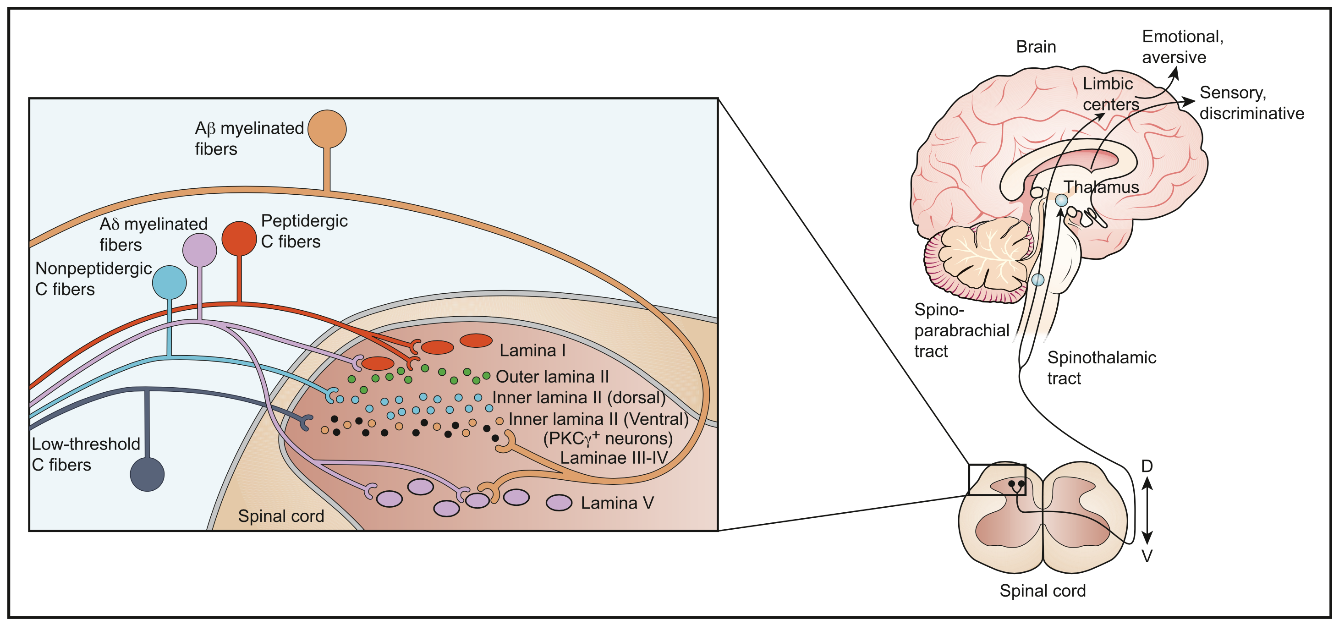
Lecture 05 | 110620
Transmission in the spinal cord
Precise, highly organized lamina structure in dorsal horn of spinal cord
Pseudo-unipolar neurons: “bidirectional signalling machine”
CHOONG-WAN WOO | COCOAN lab | http://cocoanlab.github.io
Basbaum et al., 2009; Braz et al., 2014

Slide 11
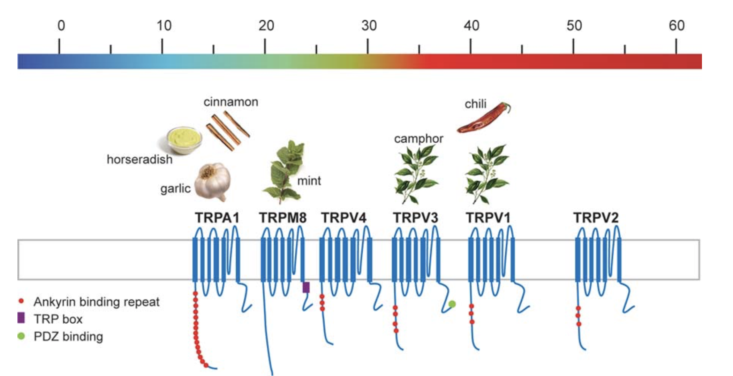
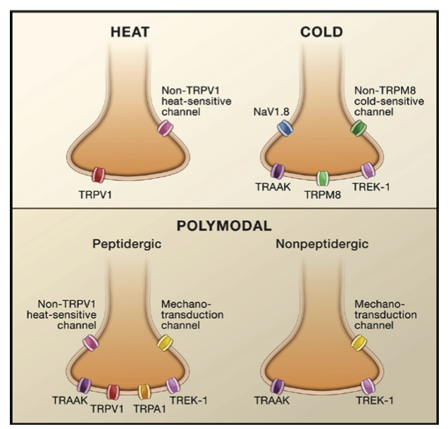
Lecture 05 | 110620
Molecular characterization of “labeled lines”
Specialized receptors for different types of stimuli:
TRP (transient receptor potential)
Sodium channels (Nav 1.8, 1.9)
Potassium channels (TREK, TRAAK)
Some (but not all) primary afferent fibers are “labeled lines”
E.g., C fibers are polymodal: react to thermal, mechanical, or chemical
Controversial whether labeled lines exist in the spinal cord and above
CHOONG-WAN WOO | COCOAN lab | http://cocoanlab.github.io
Basbaum et al., 2009; Dhaka et al., 2006

Slide 12

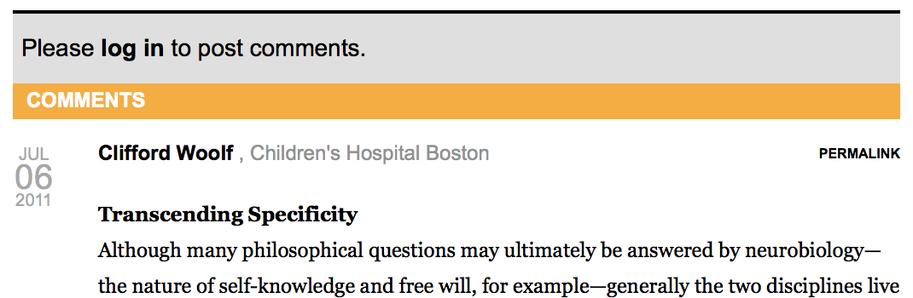
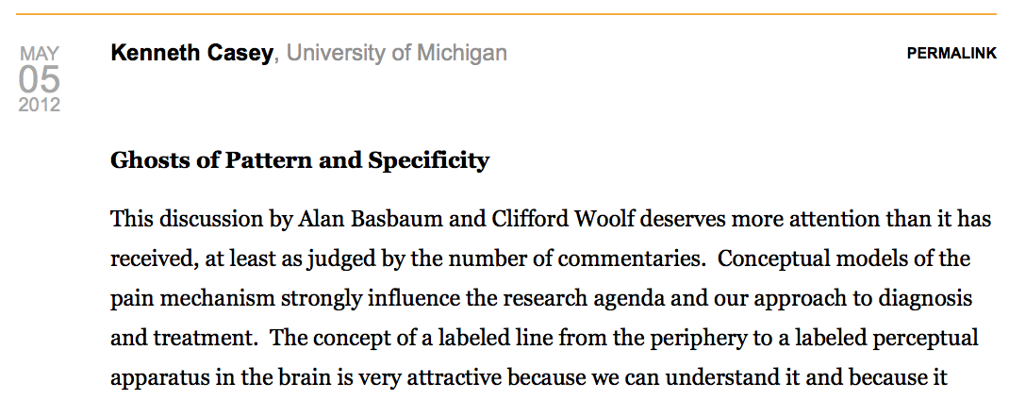
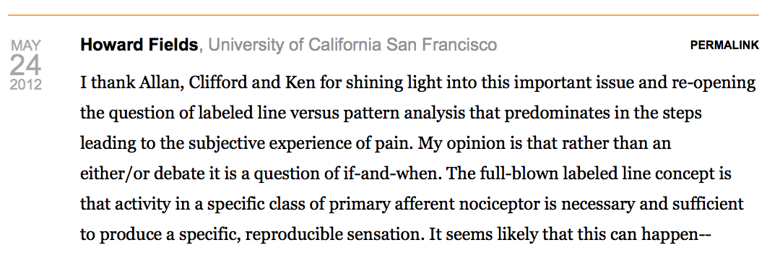
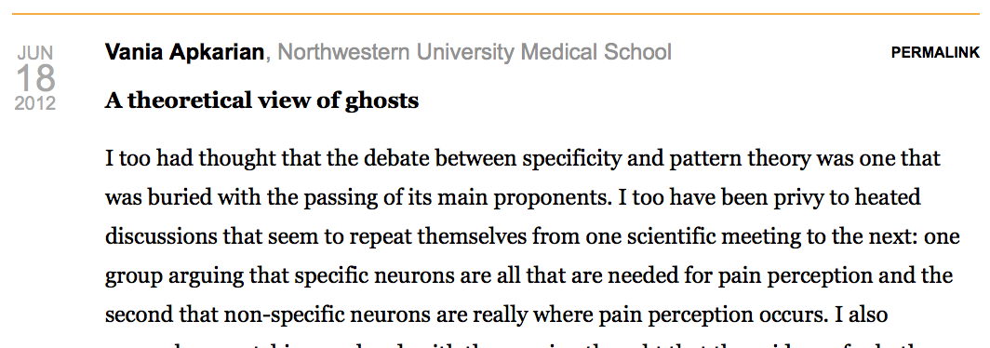
Lecture 05 | 110620
Further reading for the debate:
Further reading: https://www.painresearchforum.org/forums/discussion/7347-specificity-versus-patterning-theory-continuing-debate
CHOONG-WAN WOO | COCOAN lab | http://cocoanlab.github.io

Slide 13
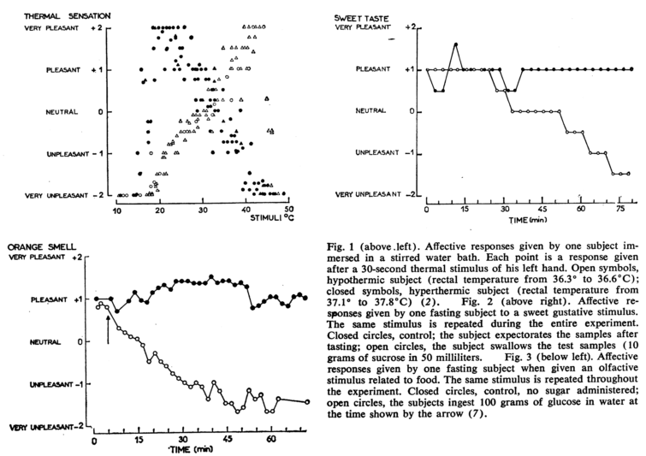
Lecture 05 | 110620
But the body context matters: Alliesthesia
CHOONG-WAN WOO | COCOAN lab | http://cocoanlab.github.io

Slide 14
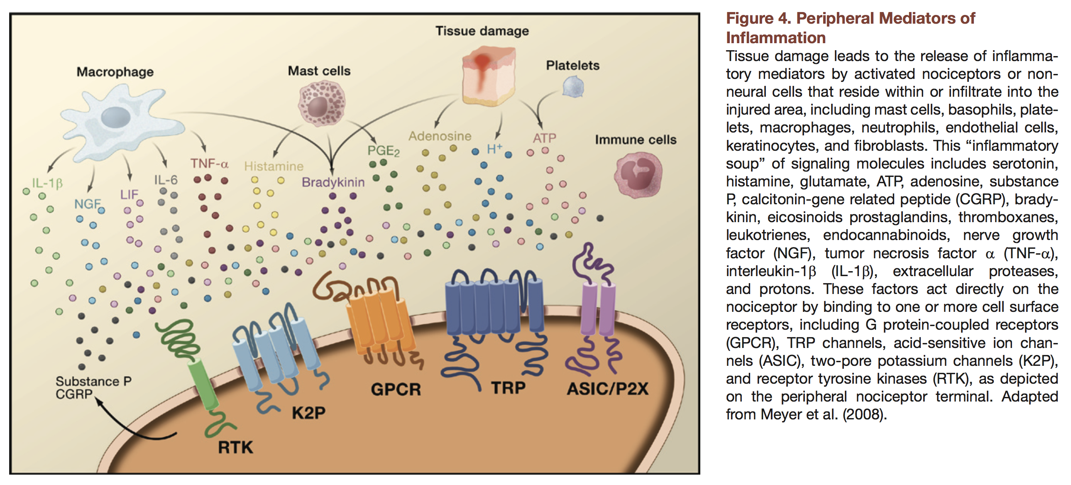
Lecture 05 | 110620
Inflammation and sensitization
CHOONG-WAN WOO | COCOAN lab | http://cocoanlab.github.io

Slide 15
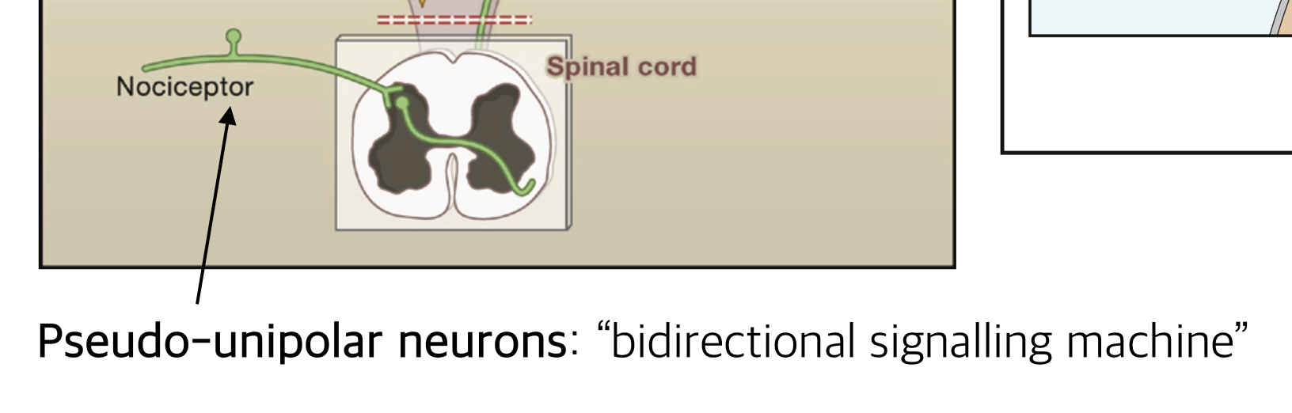
Lecture 05 | 110620
Bidirectional signaling of primary afferent nociceptors
“Primary afferent fibers have a unique morphology, called pseudo-unipolar, wherein both central and peripheral terminals emanate from a common axonal stalk. The majority of proteins synthesized by the DRG or trigeminal ganglion cell are distributed to both central and peripheral terminals.”
Basbaum et al., 2009
→ Neurochemicals in the spinal cord can influence inflammation and other factors in the skin!
CHOONG-WAN WOO | COCOAN lab | http://cocoanlab.github.io

Slide 16
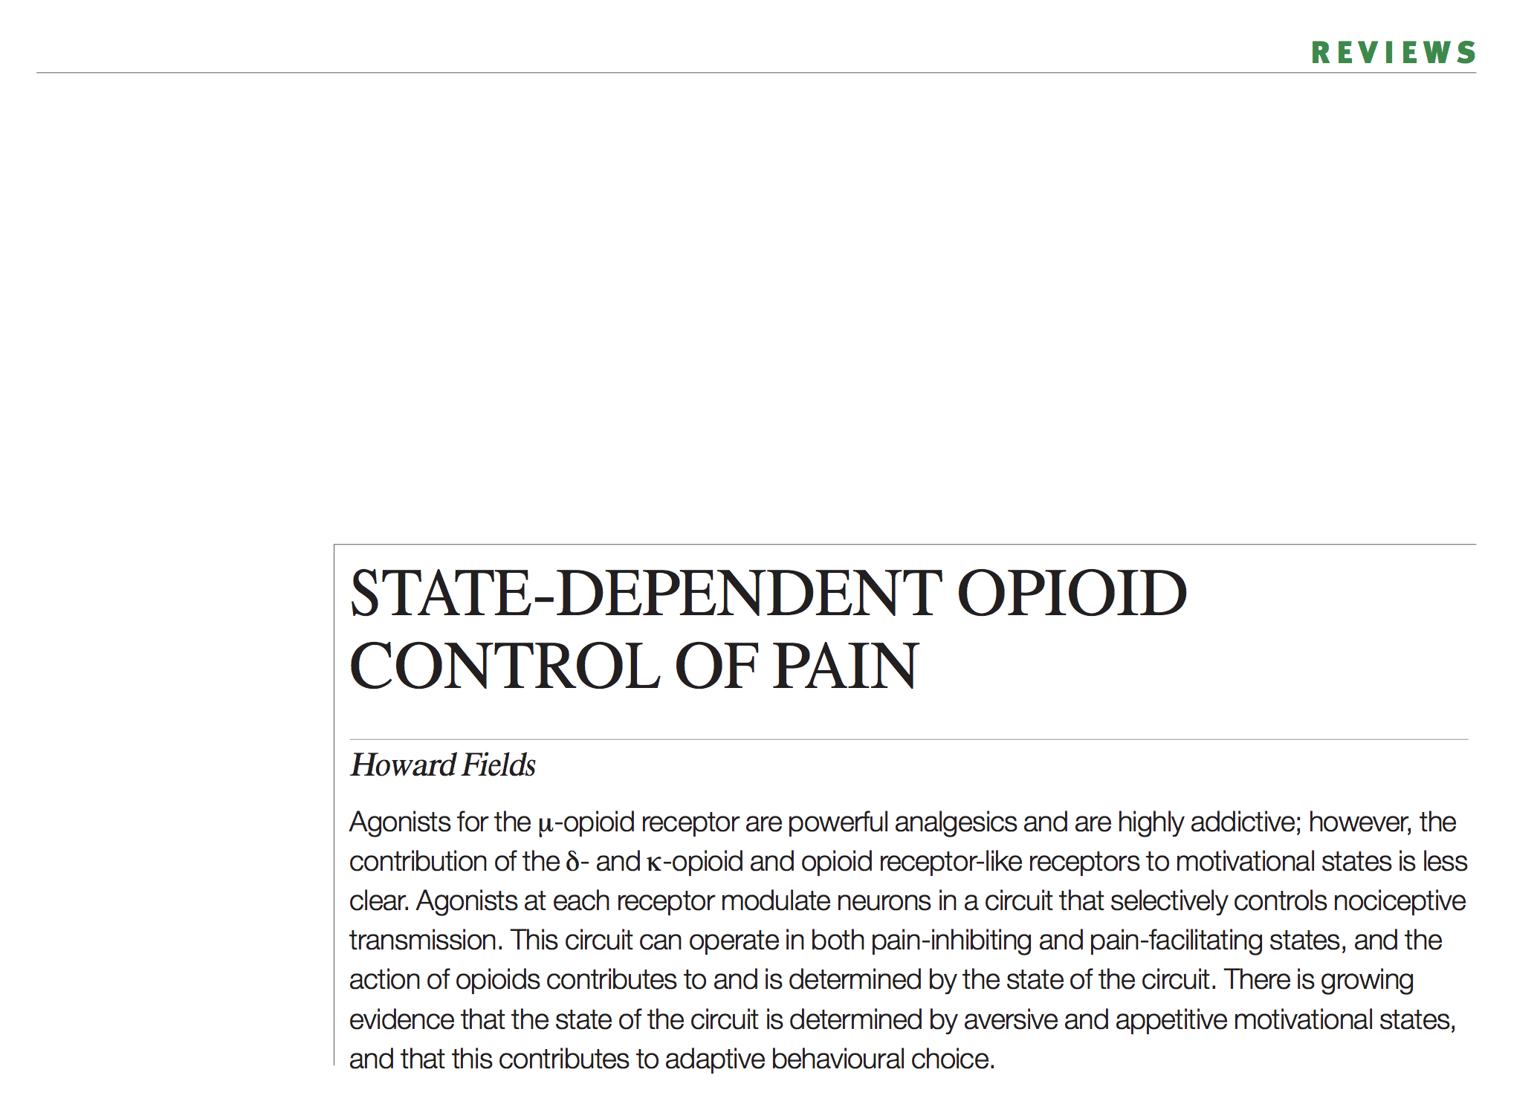
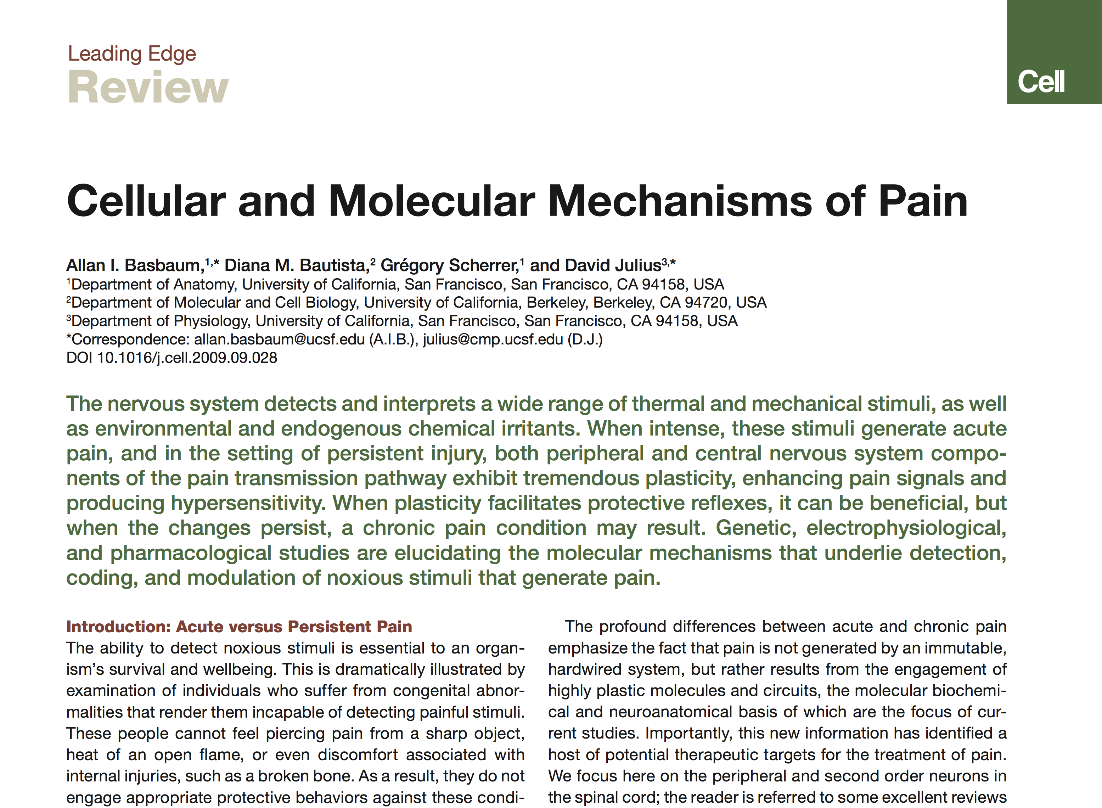
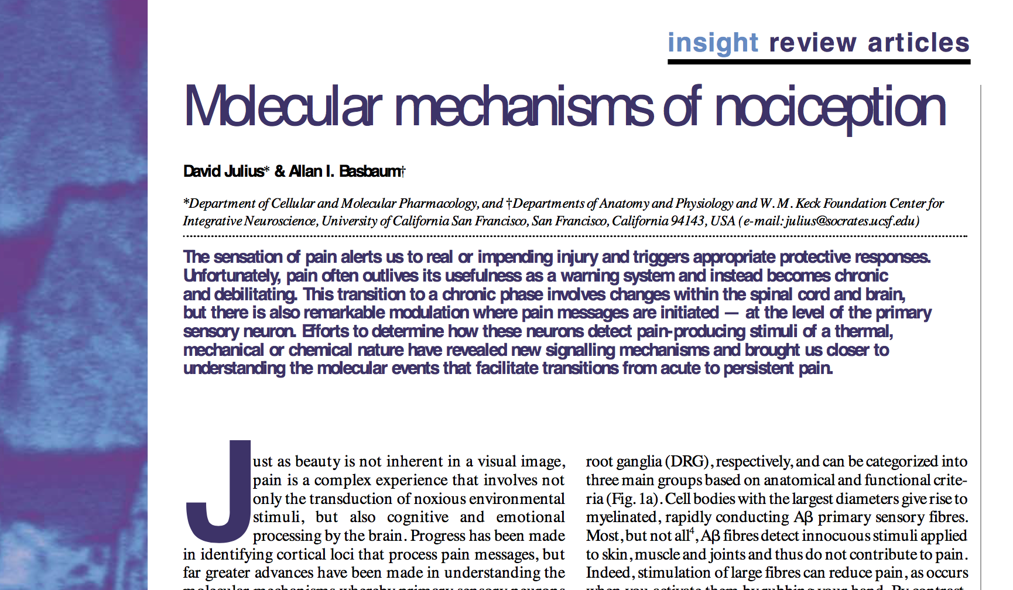
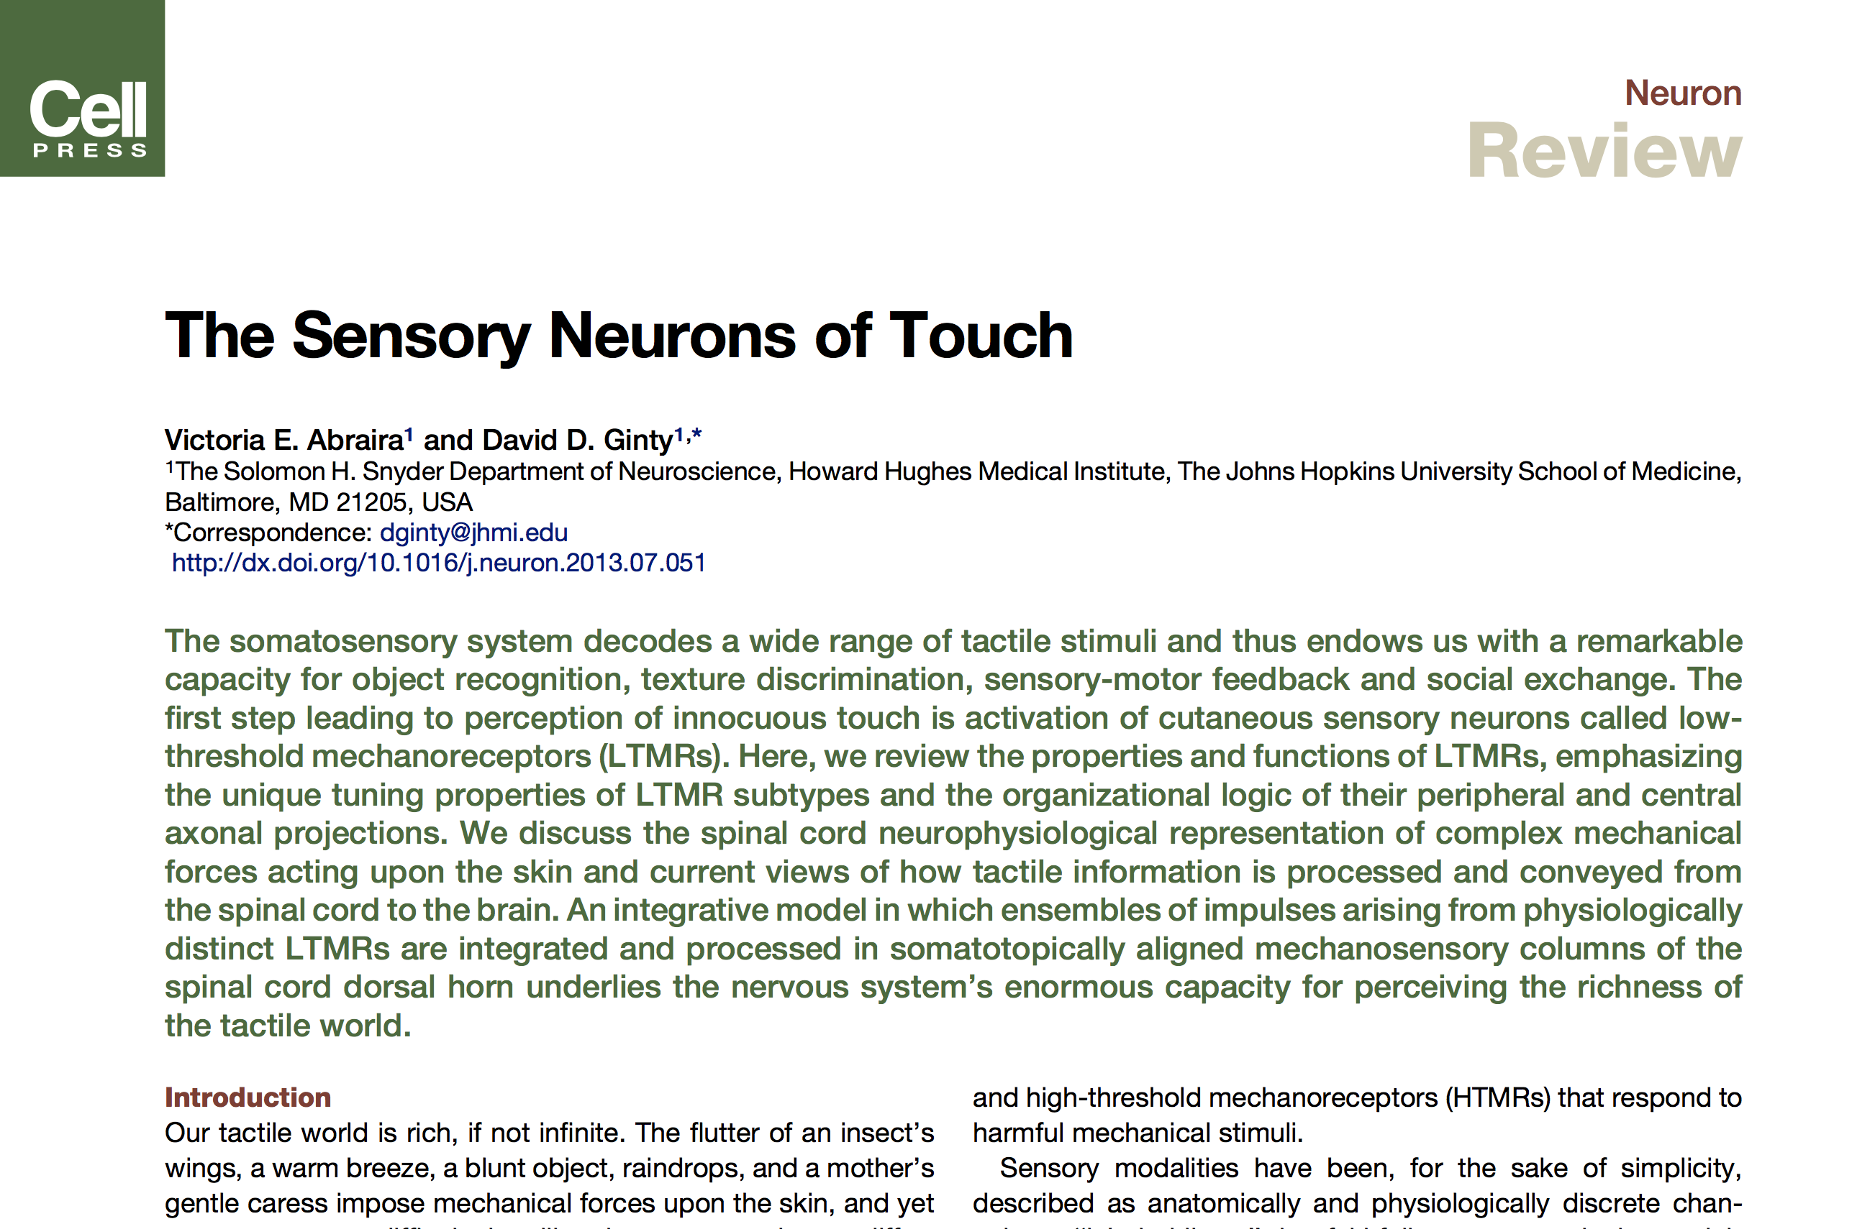
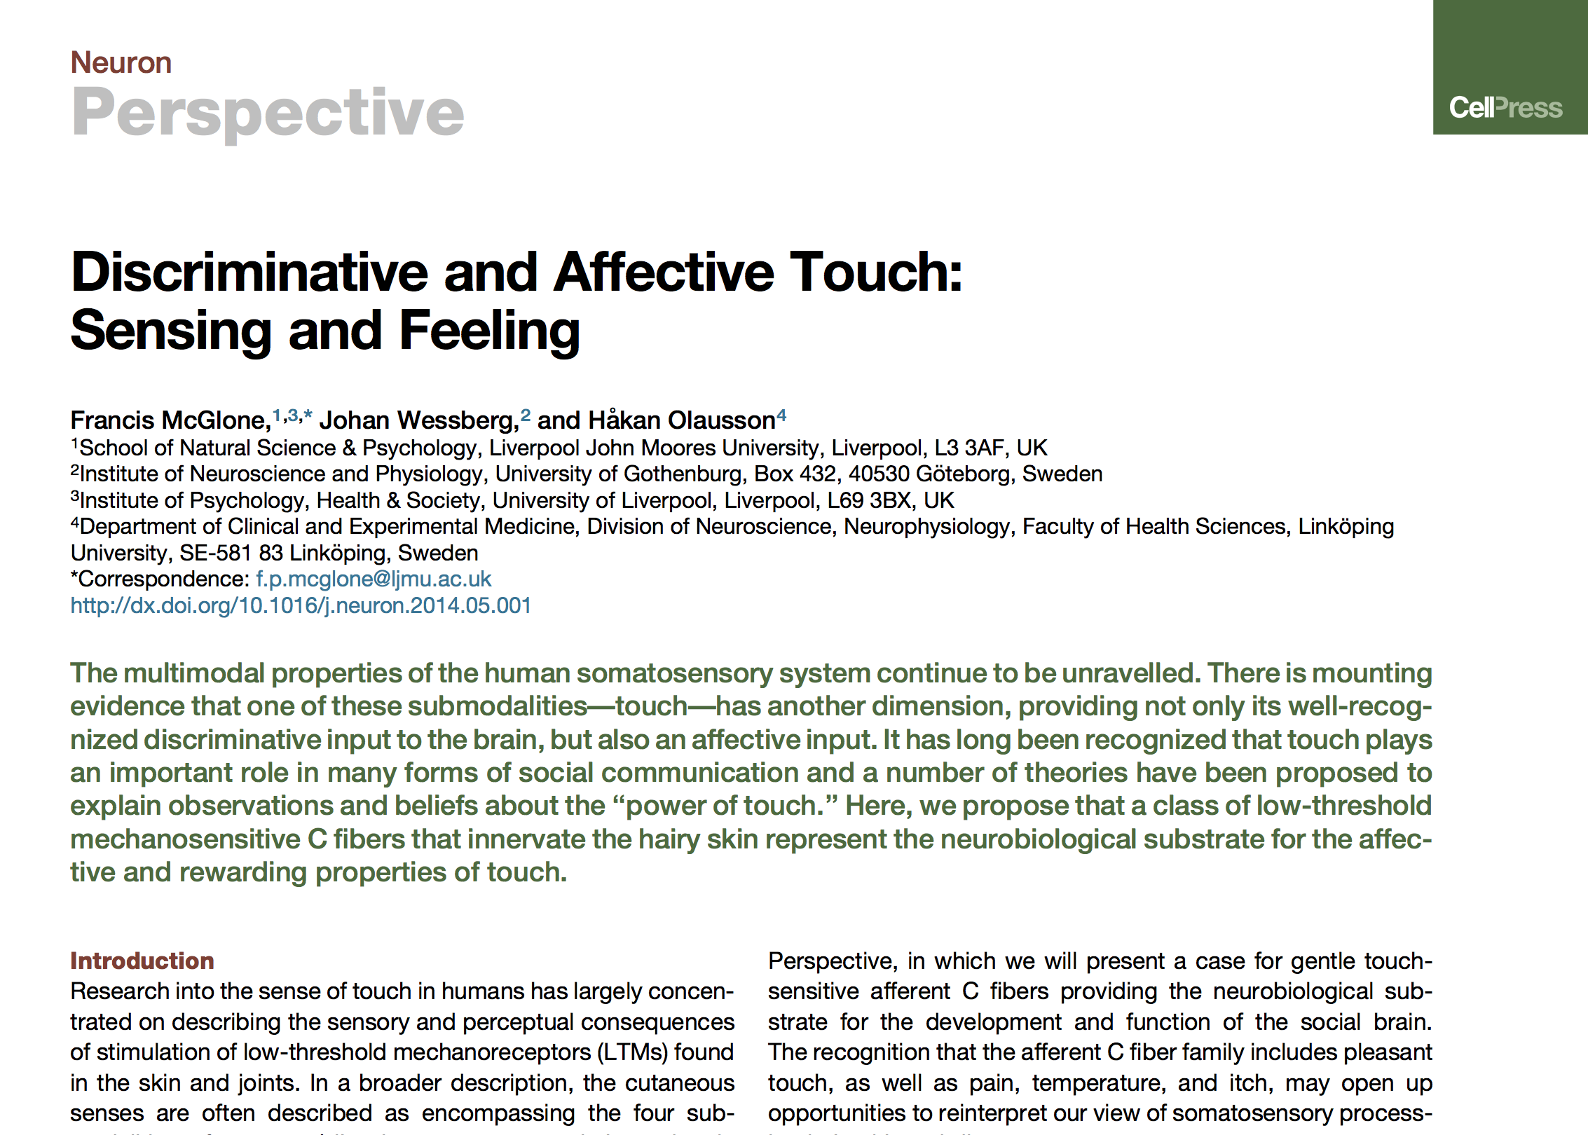
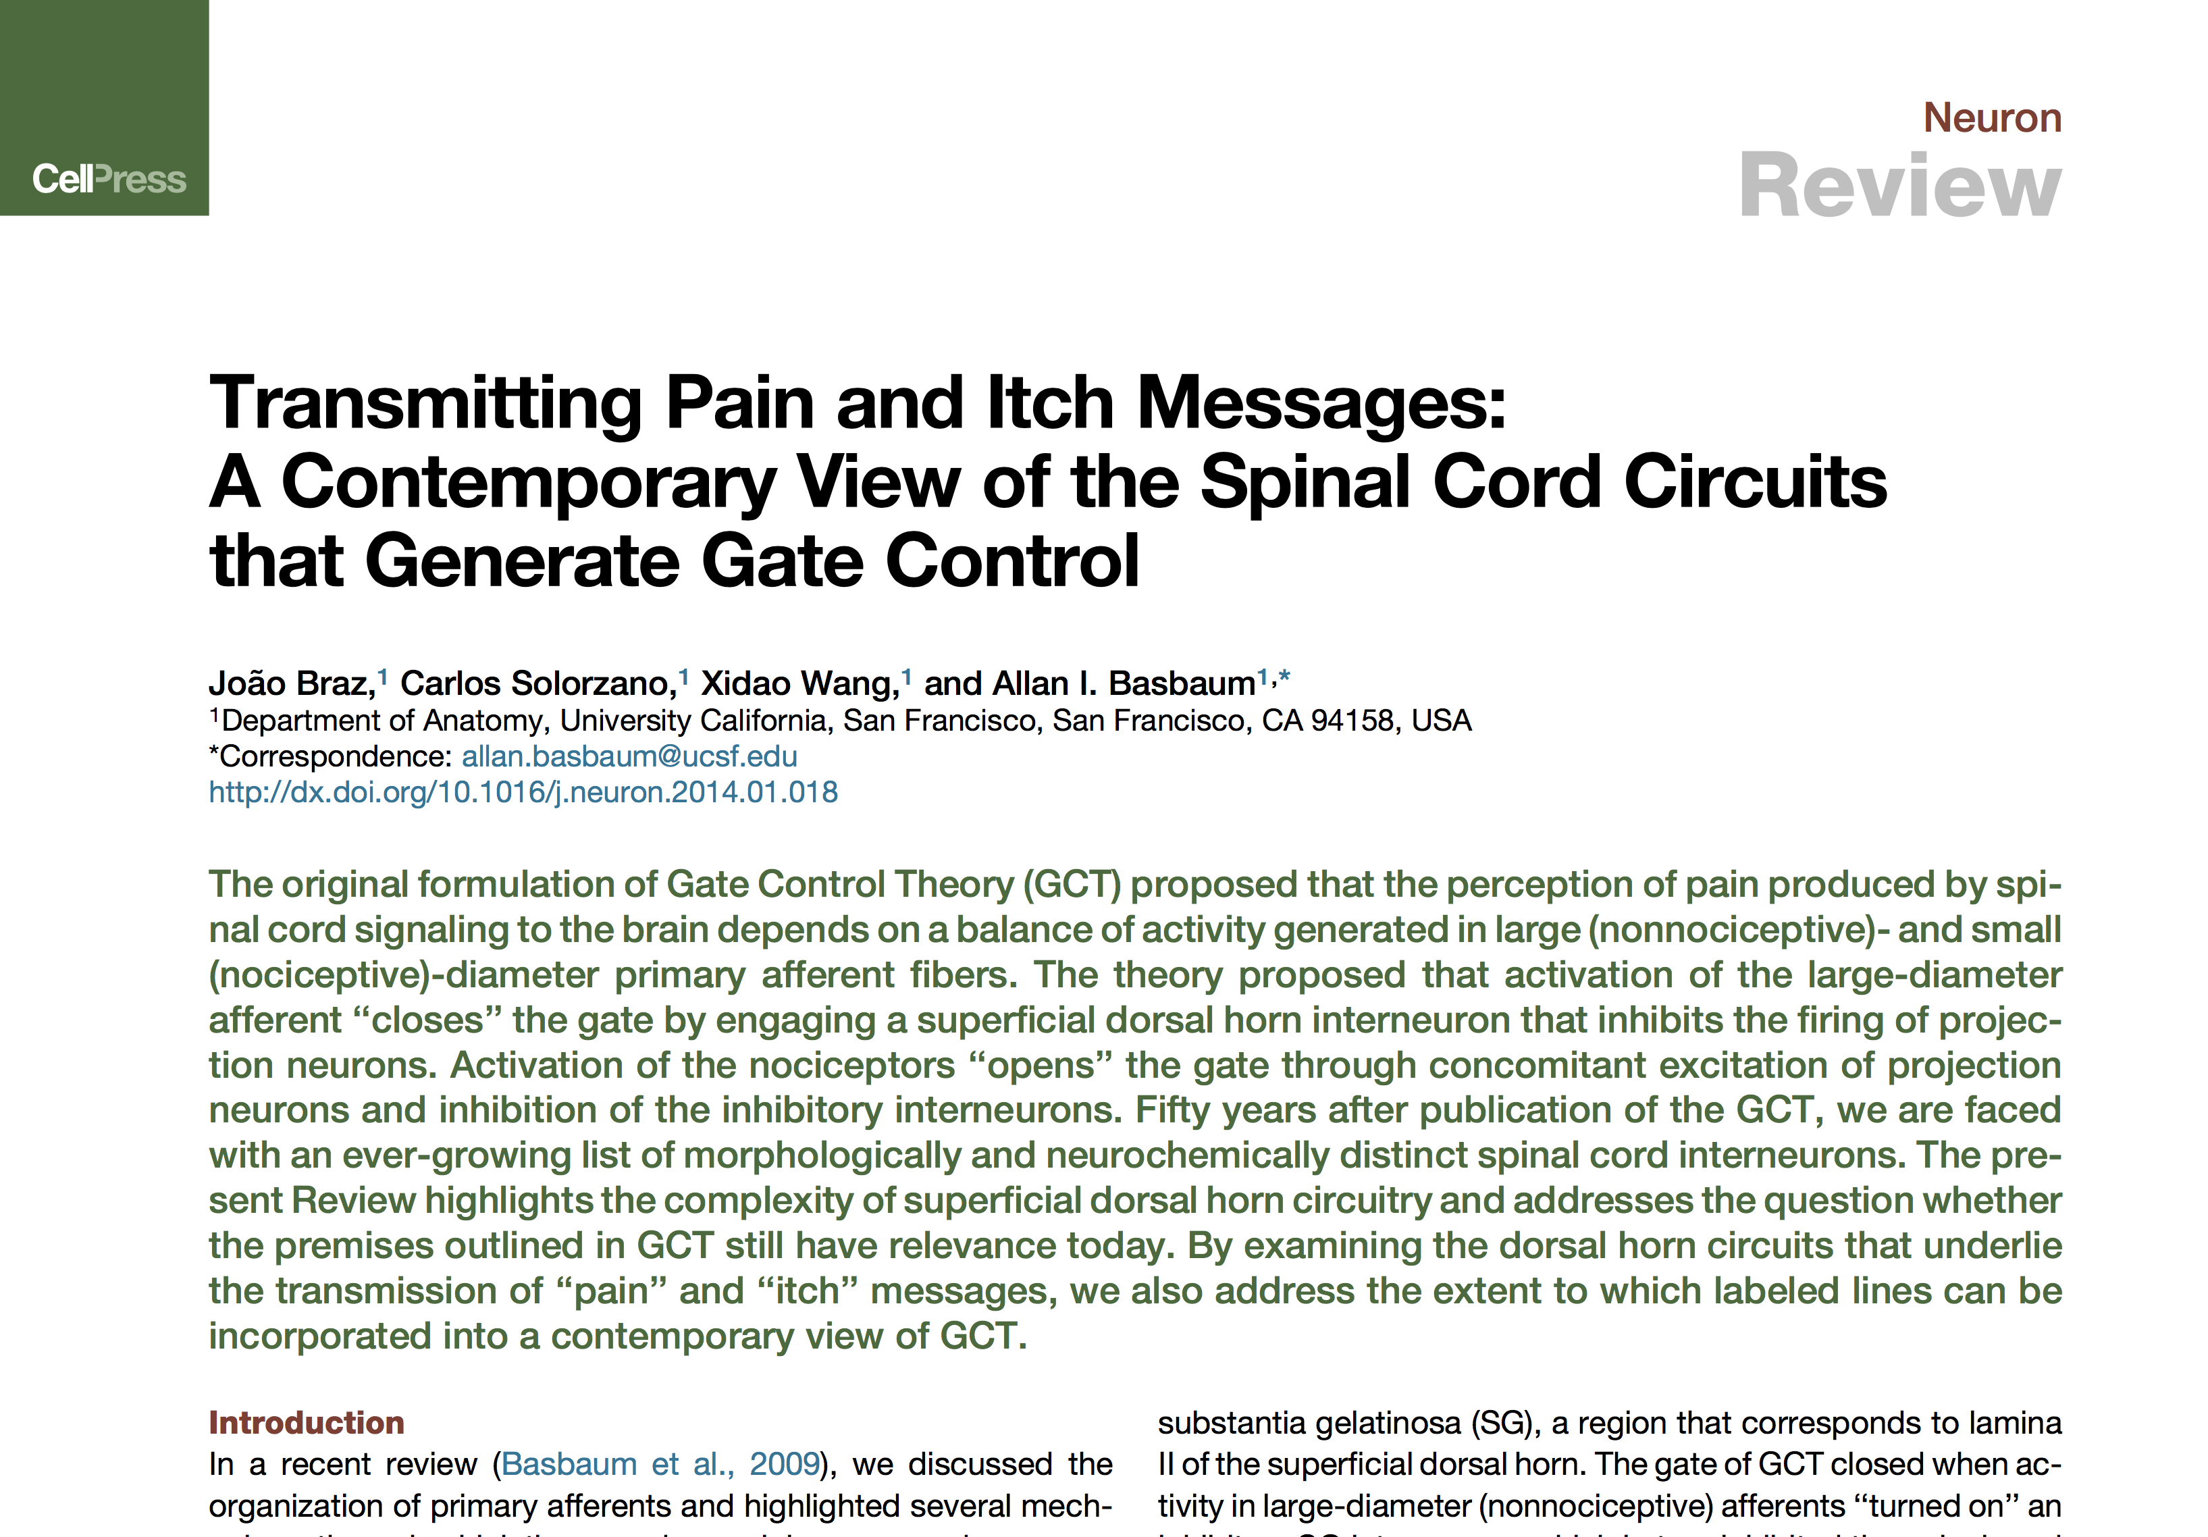
Lecture 05 | 110620
CHOONG-WAN WOO | COCOAN lab | http://cocoanlab.github.io

